Slide 1
Current update on H5N1 active cases and dairy farm biosecurity
Jason Hartschuh, OSU Extension Field Specialist Dairy Management and Precision Livestock

Slide 2
FDA requires Cat and Dog food manufacturers covered by PCAF to consider H5N1
Concerns have arisen with the use of unpasteurized milk, unpasteurized eggs, and uncooked meat are used in pet food
FDA tracking cases of H5N1 in domestic and wild cats in California, Colorado, Oregon, and Washington State associated with eating contaminated food products
Currently no detected dog cases in the US but positive case have been reported in other countries

Slide 3
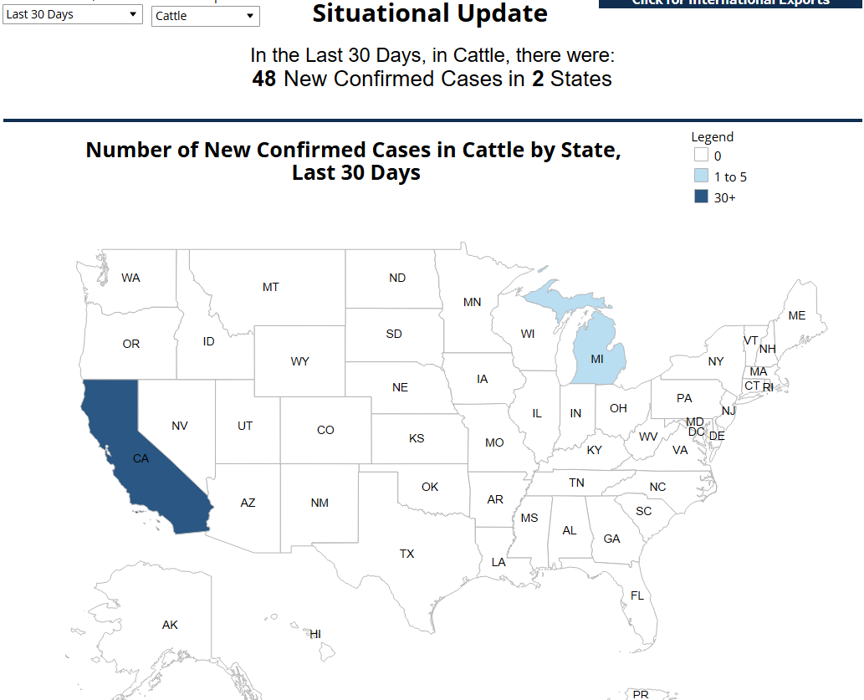
Dairy Update

Slide 4
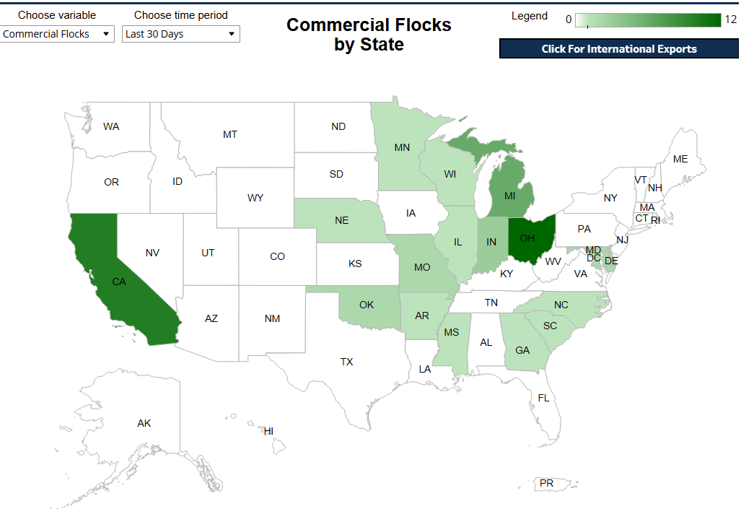
Poultry Update

Slide 5
USDA Biosecurity planning and implementation Currently 580 farms nationally have participated
Available to all dairy producers—up to $1,500 per premises + $100 for in-line milk sampler
Hiring private entities to develop site-specific plans, conduct biosecurity trainings, and perform audits.
You are compensated up to $1,500 per premises for these services after verification and inclusion on the detailed financial plan.
You can elect to work with State personnel who would develop site-specific plans, conduct biosecurity trainings, and perform audits.
States are compensated under a cooperative agreement based on the flat rates for the activities you have chosen.

Slide 6
How to start the biosecurity funding process
Contact your Area Veterinarian in Charge or State animal health official to enroll.
Sign an agreement detailing the options you want to use; this includes a stipulation for USDA personnel to conduct a review every 30 days to monitor implementation of these options.
Develop your biosecurity plan either through local veterinarians, USDA personnel, or other professionals.

Slide 7
How to start the biosecurity funding process
Register with the U.S. Government System for Award Management (SAM), which provides a mechanism of payment, or an alternative payment method (electronic funds transfer or paper check). SAM payments are the most timely.
If producers have participated in NRCS program they may already be part of the SAM system
Track expenses and maintain receipts for reimbursement.
Labor hour for farm workers to complete biosecurity training
Working with State animal health personnel (compensated through a cooperative agreement with the State) or hiring a private entity to:
Develop site-specific biosecurity plans
Develop and/or provide biosecurity training
Conduct a biosecurity audit

Slide 8
Where to start on understanding what is needed in a plan
SMS Secure Milk Supply-https://securemilksupply.org/milk-producers/
The focus of SMS was originally Foot and Mouth Disease
Focus areas
Lines of separation
Employee training
Equipment movement
Vehicles coming to the farm
Incoming animals to the farm
Manure management
Rodent and wildlife control (this is big)
Quarantine area beyond hospital pen for infected animals

Slide 9
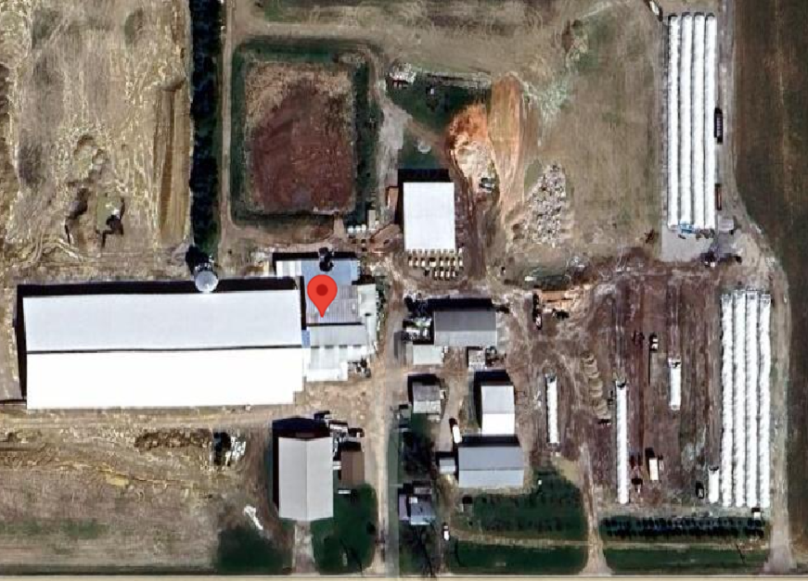
Line of separation conundrum in dairy

